Slide 1




Europe’s Civil Protection Readiness People. Interoperability. Trust.

Slide 2
Christophe Marchal Vice-president of the French Firefighters’ Federation Vice-president of the International Association of Fire ans Rescue Services (CTIF)

Slide 3
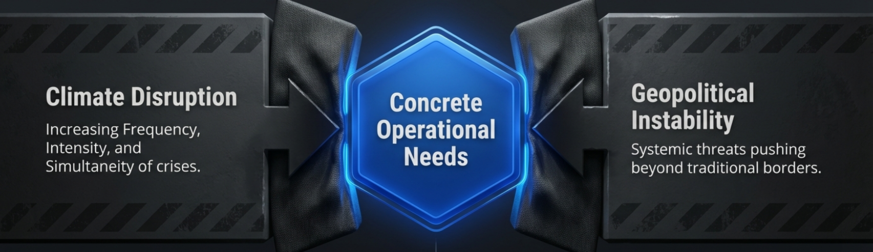
More crises. More complexity. More need for preparedness.

Slide 4

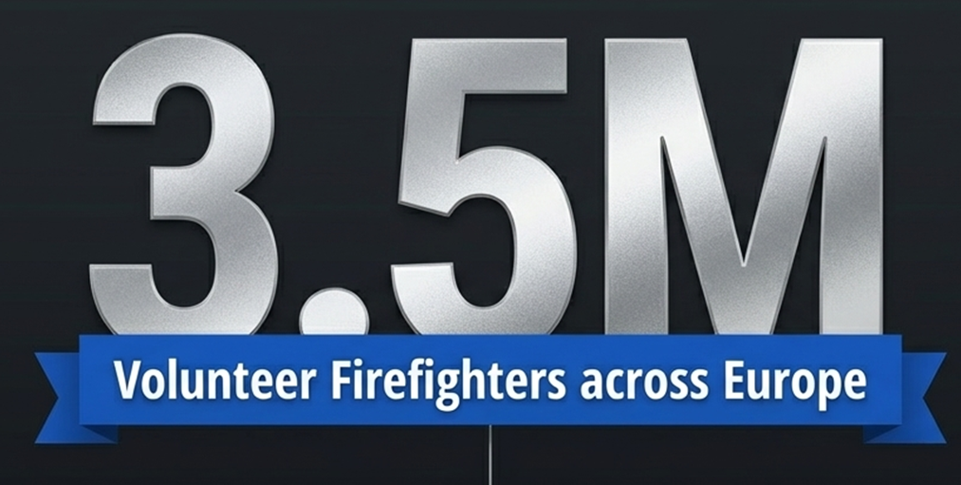
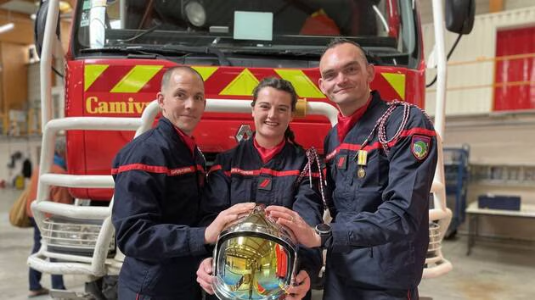
Firefighters in Europe
First on the ground
Citizens among citizens
Essential response capacity
Sources: Eurostat and CTIF

Slide 5
Protect volunteering in civil protection
Legal uncertainty puts pressure on volunteering
Need for a clear and proportionate framework
Europe must protect those who protect Europe

Slide 6

No Member State can manage major crises alone
Mutual assistance is essential
ERCC
rescEU
EUCPM

Slide 7
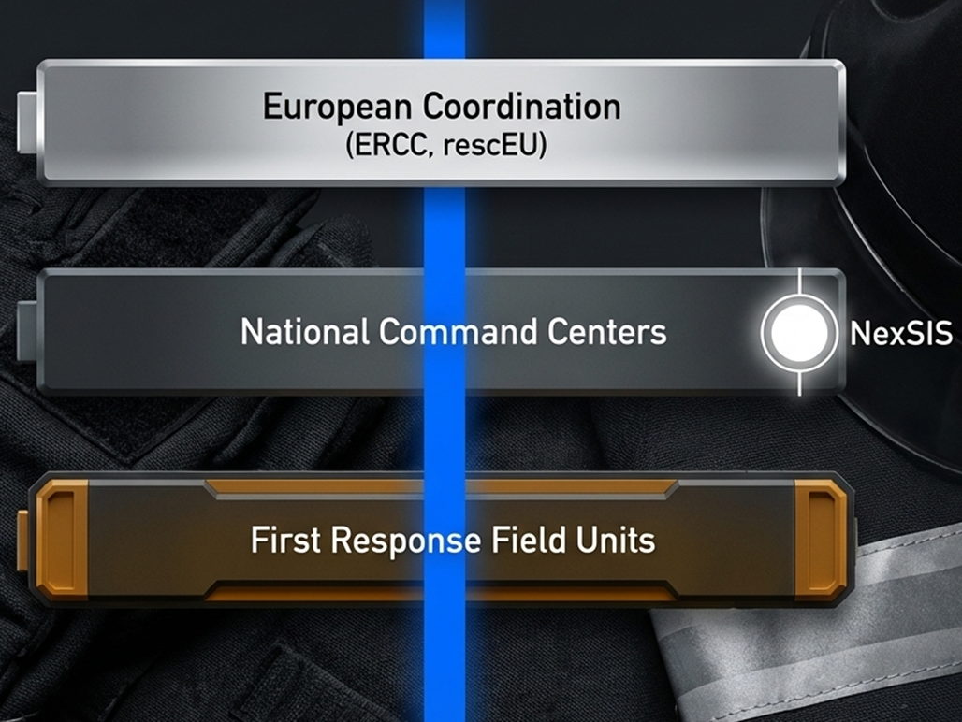
Interoperability is now an operational priority

Slide 8
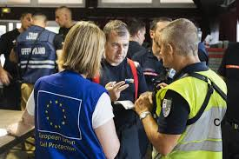
Train together to respond together
Firefighters Erasmus
Shared operational reference
Common safety foundations
Work together, whatever the Member State

